Slide 1

Big Data Analysis with IBM Cloud Databases
BY
CHANDRAVEL .P
DHANUSH .P
DINESH .N
HABISHEK .R
HARISH KUMAR .P

Slide 2
Abstract
With the advent of big data, organizations are facing unprecedented volumes of data that require advanced analytical techniques for meaningful insights. This paper explores the utilization of IBM Cloud Databases as a powerful platform for managing and analyzing large datasets. The study delves into the key features and benefits of IBM Cloud Databases, including scalability, security, and integration capabilities. Additionally, it examines case studies showcasing real-world applications of big data analysis using IBM Cloud Databases. Through a comprehensive review of literature and practical examples, this paper aims to provide a comprehensive understanding of how IBM Cloud Databases can be leveraged for effective big data analysis.

Slide 3
Problem Statement
Dive into the world of big data analysis with IBM Cloud Databases. Uncover hidden insights from vast datasets, from climate trends to social patterns. Visualize your findings and derive valuable business intelligence. Embark on data-driven adventures, exploring the endless possibilities of big data!
The project involves delving into big data analysis using IBM Cloud Databases. The objective is to extract valuable insights from extensive datasets, ranging from climate trends to social patterns. The project includes designing the analysis process, setting up IBM Cloud Databases, performing data analysis, and visualizing the results for business intelligence.

Slide 4

Design Thinking
Data Selection
Identify the datasets to be analyzed, such as climate data or social media trends.

Slide 5
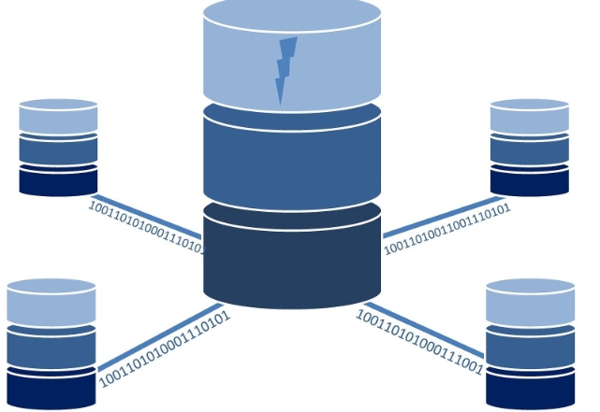
Design Thinking
Database Setup
Set up IBM Cloud Databases for storing and managing large datasets.

Slide 6

Design Thinking
Data Exploration
Develop queries and scripts to explore the datasets, extract relevant information, and identify patterns.

Slide 7

Design Thinking
Analysis Techniques
Apply appropriate analysis techniques, such as statistical analysis or machine learning, to uncover insights

Slide 8

Design Thinking
Visualization
Design visualizations to present the analysis results in an understandable and impactful manner.

Slide 9

Design Thinking
Business Insights
Interpret the analysis findings to derive valuable business intelligence and actionable recommendations.

Slide 10
Features of Big Data Analysis
Scalability
Scalability
High Availability
Automated Backups and Disaster Recovery:
Multi-Cloud and Hybrid Cloud Support
Integration Capabilities
Compatibility with Diverse Data Types
Machine Learning and AI Integration

Slide 11
Benefits:
Db2 on Cloud
IBM Db2 Warehouse on Cloud
IBM Cloud ant
IBM Cloud Databases for PostgreSQL
IBM Cloud Databases for MongoDB
IBM Db2 Big SQL
IBM Db2 Event Store
IBM Cloud Object Storage

Slide 12
Conclusion
IBM Cloud Databases represent a formidable tool for organizations looking to navigate the complexities of big data analysis. By combining scalability, security, and integration capabilities, IBM Cloud Databases offer a holistic solution that addresses the challenges posed by the era of big data. As organizations continue to grapple with ever-expanding datasets, the adoption of IBM Cloud Databases is poised to play a pivotal role in driving data-driven decision-making and fostering innovation across various industries.

Slide 13
THANK YOU

